Slide 1

IT Service Management (ITSM) With AI Summarization
Enhancing ITSM with AI-powered Summarization

Slide 2
Team 8
Prasanth Ghantasala Y00870600
Hemanth Pulikonda Y00861768
Sai Kumar Dasari Y00862154

Slide 3

Faculty Coach
Dr. Robert Gilliland
Senior Lecturer
Computer Science, Information, & Engineering Technology
ragilliland@ysu.edu

Slide 4
Contents
Introduction
Background
Problem Statement
Methodology
Experiment Results
Discussion
Conclusion
Contribution of Team Members
Architecture

Slide 5

Introduction
Definition of ITSM and its importance in managing IT services efficiently
Objective of the project: Enhancing ITSM with AI-powered summarization capabilities

Slide 6
Background
Overview of ITSM tools and their role in incident management, service requests, and changes
Challenges faced due to the growing volume of data, especially in reading and understanding lengthy reports

Slide 7
Problem Statement
Main problem: Time-consuming process of reading and comprehending lengthy incident reports and service requests
Goal: Leverage AI summarization to streamline the process and provide quick and accurate summaries

Slide 8
Methodology
Tech Stacks
Nodejs
React.js
MongoDB
AI Model: OpenAI GPT-4
Notes:
Consider talking about:
Reasoning, problem solving
Knowledge representation
Planning
Learning
Natural language processing
Perception
Motion and manipulation
Social intelligence
General intelligence

Slide 9
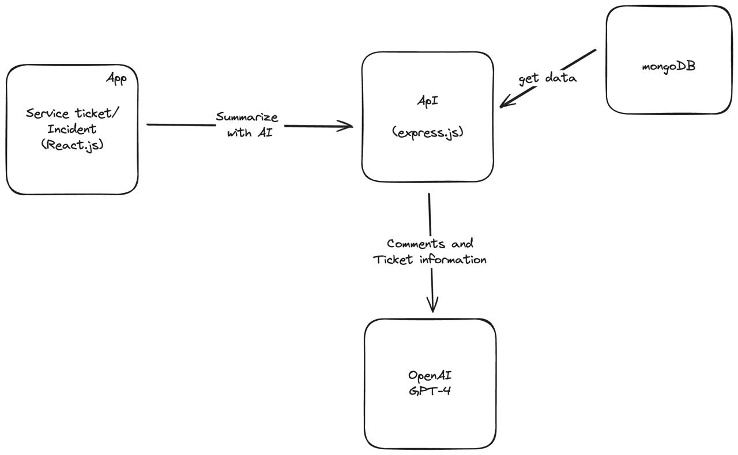
Architecture

Slide 10
Experiment Results
Conducted experiments to evaluate system accuracy
Summarize with AI feature:
Summarizes service tickets
Allows users to ask questions and get relevant information
AI model's performance:
Answers all questions
Recommends solutions with high accuracy
Notes:
Consider talking about:
Cybernetics and brain simulation
Symbolic
Sub-symbolic
Statistical learning
Integrating the approaches

Slide 11

Discussion
Issue: Integration complexity with OpenAI GPT-4
Resolution:
Conducted thorough research and experimentation
Implemented a robust communication protocol
Collaborated closely with the OpenAI community
Result: Successful integration of OpenAI GPT-4
Notes:
Consider talking about:
Cybernetics and brain simulation
Symbolic
Sub-symbolic
Statistical learning
Integrating the approaches

Slide 12

Contribution of Team Members
Prasanth: Worked on creating architecture, planning of the application mainly focusing on the backend part.
Hemanth: Created UI designs for the frontend application according to the requirements
Sai Kumar: Integrated APIs with frontend application and integrated OpenAI GPT-4 to the backend.
Notes:
Consider talking about:
Cybernetics and brain simulation
Symbolic
Sub-symbolic
Statistical learning
Integrating the approaches

Slide 13

Conclusion
Benefits of integrating AI with a data-driven application
Increased productivity and ability to provide recommendations based on the problem statement
Notes:
Consider talking about:
Healthcare
Automotive
Finance and economics
Cybersecurity
Government
Law-related professions
Video games
Military
Hospitality
Audit

Slide 14


